Slide 1
Modālie logi
Form2 ModDialog = new Form2();
ModDialog.ShowDialog();
if (ModDialog.DialogResult==DialogResult.OK)
MessageBox.Show("Processing request");
else
if (ModDialog.DialogResult==DialogResult.Cancel)
MessageBox.Show("Cancelling request");
ModDialog.Dispose();

Slide 2
Īpašība ParentForm
class DialogaLogs : Form
{
private void ParentInfo()
{ string data =
((MyForm)this.ParentForm).GetPInfo();
} ...
}
class MyForm : Form
{
...
public string GetPInfo() { ... }
}

Slide 3
void ButtonOkOnClick(
object obj, EventArgs ea)
{
...
Dialog.Result = DialogResult.OK;
}
...
btn.Click += new EventHandler(ButtonOkOnClick);

Slide 4
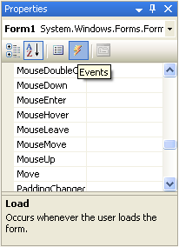
Formas notikumi
Load
Activated
Deactivate
FormClosing
FormClosed
Paint
Resize
Move

Slide 5
using System;
using System.Drawing;
using System.Windows.Forms;
class PaintEvent
{
public static void Main()
{
Form form = new Form();
form.Text = "Paint Event";
form.Paint += new
PaintEventHandler(MyPaintHandler);
Application.Run(form);
}
static void MyPaintHandler(
object objSender, PaintEventArgs pea)
{
Graphics grfx = pea.Graphics;
grfx.Clear(Color.Chocolate);
}
}

Slide 6
Notikuma Paint delegāts
public delegate void PaintEventHandler(
object objSender,
PaintEventArgs pea);
form.Paint += new PaintEventHandler(MyPaintHandler);
static void MyPaintHandler(
object objSender,
PaintEventArgs pea) { ... }

Slide 7
Klase PaintEventArgs
ClipRectangle
Graphics
Graphics grfx = pea.Graphics;
grfx.Clear(Color.Chocolate);

Slide 8
using System;
using System.Drawing;
using System.Windows.Forms;
class HelloWorld : Form
{
public static void Main()
{
Application.Run(new HelloWorld());
}
public HelloWorld()
{
Text = "Hello World";
BackColor = Color.White;
}
protected override void
OnPaint(PaintEventArgs pea)
{
Graphics grfx = pea.Graphics;
grfx.DrawString("Hello!", Font,
Brushes.Black, 0, 0);
}
}

Slide 9
Klase Windows.Forms.Application
Run – sāk programmas izpildi
Exit – pārtrauc programmas darbu
DoEvents – notikumu apstrāde

Slide 10
using System;
using System.Drawing;
using System.Windows.Forms;
class MyForm1 : Form
{
public static void Main()
{
MyForm1 frm = new MyForm1();
frm.Text = "1";
frm.Show();
Application.Run();
}
protected override void OnClosed(EventArgs e)
{
MyForm2 frm = new MyForm2();
frm.Text = "2";
frm.Show();
}
}
class MyForm2 : Form
{
protected override void OnClosed(EventArgs e)
{
Application.Exit();
}
}

Slide 11
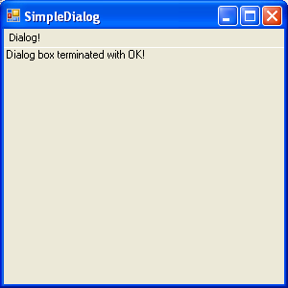
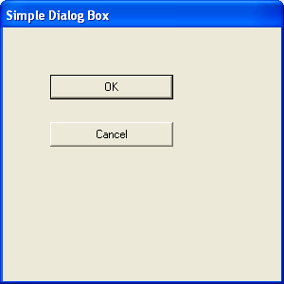
Modālie dialogu logi

Slide 12
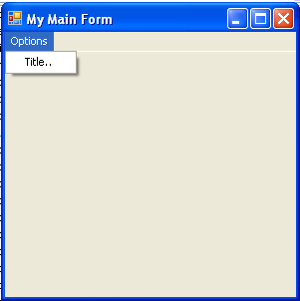
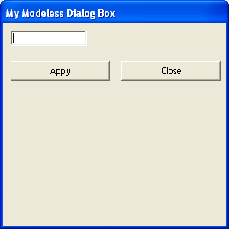
Nemodālie dialogu logi

Slide 13
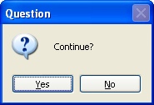
Klase MessageBox
if (MessageBox.Show("Continue?",
"Question",
MessageBoxButtons.YesNo,
MessageBoxIcon.Question) ==
DialogResult.Yes)
{ ... }

Slide 14
OpenFileDialog fdlg = new OpenFileDialog();
fdlg.Title = "Open Image";
fdlg.InitialDirectory = "C:\\";
fdlg.CheckFileExists = true;
fdlg.Filter = "Bitmap files (*.bmp)|*.bmp|" +
"Jpeg files (*.jpg)|*.jpg|" +
"All valid files *.bmp;*.jpg)|*.bmp;*.jpg";
fdlg.FilterIndex = 2;
if (fdlg.ShowDialog() == DialogResult.OK)
try
{
pictureBox1.Image =
Image.FromFile(fdlg.FileName);
}
catch (Exception ex)
{
MessageBox.Show("Error");
}

Slide 15
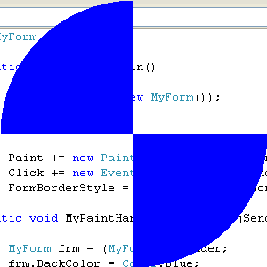
Patvaļīgas formas logi

Slide 16
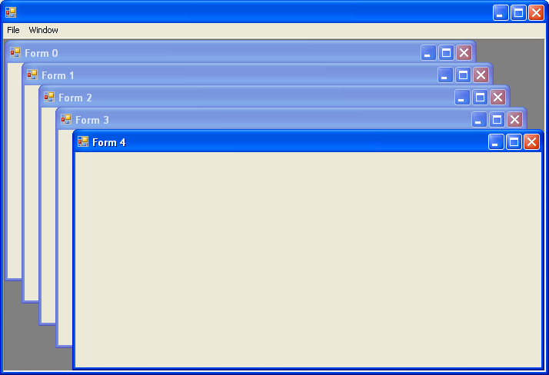
MDI lietojumi

Slide 17
Darbs ar tastarūru
protected override void OnKeyUp(
KeyEventArgs kea) { ... }
void MyKeyDownHandler(object objSender,
KeyEventArgs kea) { ... }
cntrl.KeyDown += new KeyEventHandler(
MyKeyDownHandler);

Slide 18
Klases KeyEventArgs īpašības
KeyCode (tipa Keys) – identificē taustiņu
Modifiers (tipa Keys) – identificē reģistru (Alt,Ctrl, Shift)
KeyData (tipa Keys) – īpašību KeyCode un Modifiers kombinācija
Shift (tipa bool) – ir vienāda ar true, ja ir nospiests Shift taustiņš

Slide 19
Klases KeyEventArgs īpašības
Control (tipa bool) – true, ja ir nospiests Ctrl
Alt (tipa bool) – true, ja ir nospiests taustiņš Alt
Handled (tipa bool) – nosaka vai ir nepieciešama notikuma turpmāka apstrāde
KeyValue (tipa int) – īpašības KeyData analogs

Slide 20
Keys uzskaitījuma pielietošana
protected override void OnKeyDown(
KeyEventArgs kea)
{
if (kea.KeyCode == Keys.X)
Close();
}
vai
if (kea.KeyCode == (Keys)(int)'X') ...

Slide 21
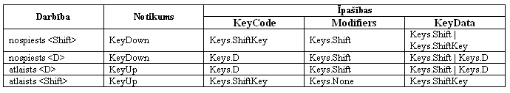
<Shift> + <D>

Slide 22
Klases Control īpašība ModifierKeys
Keys keysMod = Control.ModfierKeys;
if (keysMod ==
(Keys.Shift | Keys.Control))
{
// nospiesti Shift un Ctrl
}

Slide 23
Klases KeyPressEventArgs īpašības
KeyChar (tipa char) – ievadīta simbola kods
Handled (tipa bool) - nosaka vai ir nepieciešama notikuma turpmāka apstrāde

Slide 24
Klases darbam ar peli
Klases SystemInformation īpašības
  MouseBottons
  MouseButtonsSwapped
  MouseWheelPresent

Slide 25
Klases Contol notikumi
OnMouseDown
OnMouseUp
OnMouseMove
OnMouseWheel
Parametrs tipa MouseEventArgs
Click
DoubleClick
MouseEnter
MouseLeave
MouseHover
Parametrs tipa EventArgs

Slide 26
Klase MouseEventArgs
X (tipa int)
Y (tipa int)
MouseButtons (tipa Button) – var pieņemt vērtības:
  MouseButtons.None, MouseButtons.Left, MouseButtons.Right, MouseButtons.Middle, MouseButtons.XButton1, MouseButtons.XButton2
Clicks (tipa int)
Delta (tipa int)

Slide 27
Notikumi peles klikšķu apstrādei
Click (onClick)
DoubleClick (OnDoubleClick)

Slide 28
Notikumi peles pārvietošanas apstrādei
MouseEnter (OnMouseEnter)
MouseLeave (OnMouseLeave)
MouseHover (OnMouseHover)

